Slide 1
Chapter 4 Bidding for Ad Spaces
How does Google sell ad spaces?

Slide 2
Online Ad Business
Oxford English Dictionary added word “google” in 2006
Online ad industry worldwide reached over $160 billion in 2015
In 2014, Google generated revenue of $66 billion with over 55,000 employees
Google generated almost 90% of its revenue from ads alone in 2014
How does Google make money from its advertising business?
68.3%+21.2% = 89.5%

Slide 3
Pay per What?
“Banners displaying ads” were originally sold by websites (sellers) to advertisers (buyers) on a Pay-Per-Thousand-Impressions (PPTI) basis
each time buyer’s banner aggregates 1,000 new views, advertiser pay seller some predetermined amount of money
Is this really the best way to charge advertisers?
Seeing (viewing) an ad does not guarantee a person will click on it, let alone buy something from it
“limited indication” as to how much advertisers will gain from putting up the ad
How about pay-by-click (rather than by-view)?

Slide 4
Pay-by-Click
Advertisers submit bids for how much they are willing to pay to appear at “top” (spaces) of search results page (in response to specific search queries)
Bids are on a Pay-Per-Click (PPC) basis
Advertiser would pay amount of its bid every time a person clicked link on page to go to its website
Known as sponsor search model and search ads
Search ads were listed in descending order of PPC bids
Google’s AdWords division offers keyword advertising with pay-by-click pricing as a feature of Google’s search engine

Slide 5
Who Invented Pay-Per-Click?
Invented in 1998 by GoTo, a search engine company
Google, funded in 1998, established its AdWords division by 2000 to offer keyword advertising with pay-per-click pricing as a feature of Google’s search engine
GoTo was renamed in 2001 to Overture Services
Overture Services filed a lawsuit against Google in 2002, ending in a settlement in which Google gave stock to Overture in return for a license to use pay-per-click search advertising
Overture was subsequently acquired by Yahoo! in 2003 for its own search marketing services

Slide 6
Advertising Online
To advertise your site through Google search, through AdWords, input content to be displayed (link to your site and descriptive text) and assign keywords to your ad
When someone enters a query into Google search bar containing words associated with your ad, yours may pop up in search results

Slide 7
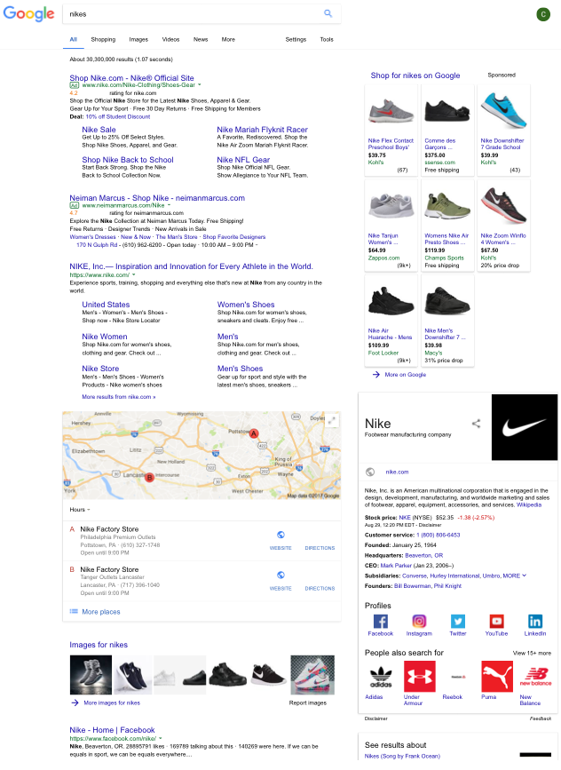
Google Pages
Standard search
results
Sponsored ads matching search keywords

Slide 8
Advertising Online
Where will your ad be placed in ad space?
real estate mantra?
location, location, location
answer depends on how much you are willing to pay for sponsorship - different amounts from different advisers
Allocated through an auction
you and others aiming for same keywords are bidders
at end of auction, highest bidder will get best spot
When do advertisers pay Google?
with PPC, Google gets paid every time an ad is clicked
How to quantify?
Click-through rate (CTR): average number of times an ad space is clicked by a viewer, say, over one hour
Notes:
拍賣

Slide 9
Advertising Online
Significance of click-through rate (CTR)?
an indication of value which Google is providing
the higher the click-through rate, the more valuable the ad space
Payment by advertisers to Google is proportional to click-through rates of ad
Valuation (expected revenue) of ad space to buyer (advertiser) = CTR X [revenue per click]
e.g., an ad space receives 20 clicks each hour, and for each click, 50% chance that viewer will purchase an item; $70 average cost per item
= valuation

Slide 10
Open Auction
Auction = (bidders, items, sellers)
Open auction ➡ all bids are “publicly” announced
ascending/descending price auction
Google sells ad spaces to buyers via ad auction
Google as the single seller
In contrast, Google adopts sealed-envelope auction

Slide 11
Sealed-Envelope Auction
Each bidder submits her bid privately, and all bids are revealed simultaneously to auctioneer
Auctioneer then decides
matching (allocation)
how much to charge for it

Slide 12
Sealed-Envelope Auction
Matching: the highest bidder gets the item
How much to charge for it:
first price auction: winner pays highest bid, which is her own
second price auction, winner pays second highest bid
Why 2nd price auction?

Slide 13
2nd Price Auction
If I want an item, and I know winner will pay second highest bid, why not bid an extremely high amount, way above my own intrinsic valuation of the item?
How about you?
What will happen if everyone thinks this way?
→ extremely high price to pay (by the winner)!!!
Such knowledge should discourage people from bidding higher than their true valuation to avoid paying more than what it is worth

Slide 14
Bidder’s Goal
Bidder’s goal in auction?
hint: value vs. price
→ Maximize net benefits received, termed payoff (special case of net utility 😊)
When winning, payoff = ?
= valuation – price paid
Can payoff be negative (when winning)?
yes!
When losing, payoff = ?
0
How can a bidder maximize her own payoff?
depends on type of auction used

Slide 15
First Price Auction
How to maximize payoff for first price auction?
Payoff = valuation – own bid (price paid)
value is constant (with respect to individual bidder)
bid (price paid) is dynamic
What factor does your win/loss depend on?
on everyone else’s bid
Strategy → to maximize payoff,
bid below individual valuation
otherwise winning can only result in a non-positive (0 or negative) payoff

Slide 16
Second Price Auction
Payoff = valuation – 2nd highest bid (price paid)
Knowledge of 2nd price should discourage everyone from bidding higher than their true valuations, to avoid paying more than what it’s worth to them
Encourage truthful bidding: best strategy of each bidder is to submit her (individual) true valuation as her bid
Why?
Assume your true valuation of item is $50
Changing bids cannot improve (increase) payoff!
Bidding truthfully is like consuming based on demand curve (usage-based pricing)
Won originally;
original payoff: $2
Lost originally; original payoff: $0

Slide 17
The Second Price Is Right
It’s in everyone’s best interest to bid truthfully
As bidders think about what their bid should be, there’s an implicit feedback signal that encourages them to set it to their intrinsic valuations
Idea of “decoupling decision of who wins from what price the winner pays” is the key
Will 3rd, 4th, etc. be even better than 2nd price auction?
2nd price is the only one that will make each user capture her own negative externality imposed on auction (one kind of network)
because winner’s payment is second highest bidder’s bid, winner is paying for fact that second highest bidder did not win
Common theme in “networking”
forcing users to internalize their negative externalities by sending them signals about their impact

Slide 18
Taxonomy of Single Item Auction
Descending price
= 1st price
Auctioneer keeps decreasing price until it reaches highest bidder’s level, at which point highest bidder stops auction
As long as this highest bidder doesn’t wait for it to drop further (i.e., she is cautious), she pays her own valuation, which is the highest price

Slide 19
Taxonomy of Single Item Auction
Ascending price
≆ 2nd price
While price is increasing, all bidders have their own valuations in mind, and each will stay in game until current bid is higher than his/her valuation
Current price keeps escalating until bidder with second highest valuation opts out
Unless winner increased current price drastically, she pays second highest bidder’s valuation (plus some small difference)

Slide 20
Generalized 2nd Price Auction
Given that Google has multiple ad spaces to sell, its auctions are multi-item auctions
Valuation of a particular ad space to a bidder =
[click-through rate] X [expected revenue per click]
Ben’s expected revenue per hour for Ad Space III =
$40 X 1 = $40 (per hour)

Slide 21
Generalized 2nd Price Auction
What does each advertiser provide to Google in order to participate in auction?
Only revenue per click (or more precisely, the amount they value each click), rather than a separate number for each ad space
Google AdWords uses Generalized 2nd Price (GSP) auction

Slide 22
Generalized 2nd Price Auction
Bid by advertisers: each buyer submits a bid = price they are willing to pay Google per click
Matching by Google: ad spaces are allocated to buyers in descending order of bids → highest bidder gets first ad space, second highest gets second space, etc.
Payment from advertisers to Google: price each buyer pays for space follows 2nd price, single item auctions → highest bidder pays the price the second highest bidder would pay for first space, second highest bidder pays the price the third highest bidder would pay for second space, etc.
revenue per click = amount they value each click

Slide 23
Generalized 2nd Price Auction
Payment to Google →
Ben: $20x10=$200/hour
Anna: $10x5=$50/hour
Charlie: min. $3x1=$3/hour
Payoff = valuation – price paid
Payoff →
Ben: $40x10 - $200 = $200/hour
Anna: $20x5 – $50 = $50/hour
Charlie: $10x1 - $3 = $7/hour

Slide 24
Assumptions Made
Click-through rate was assumed to be independent of actual content of ad placed in the space. In reality, some ads are naturally more attractive than others, and would tend to obtain more clicks in the same space as a result
Estimated Click-through rate vs. observed # of clicks / hour

Slide 25
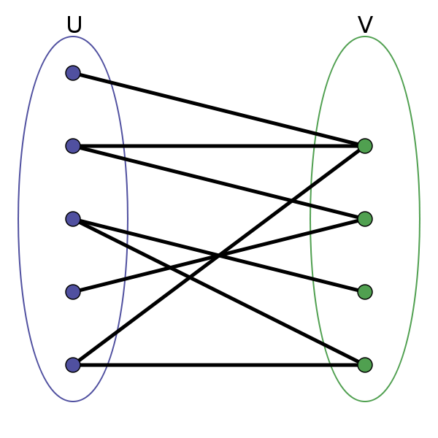
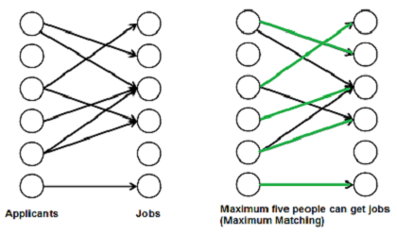
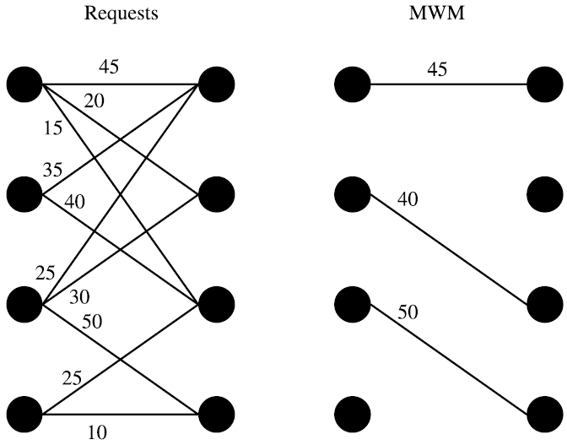
Bipartite Graph and Maximum Matching
A bipartite graph is a graph whose vertices can be divided into two disjoint and independent sets U and V such that every edge connects one vertex in U to one in V
A matching in a Bipartite Graph is a set of edges chosen in such a way that no two edges share an endpoint
A maximum matching is a matching of maximum size/weight (maximum number of edges or weight)

Slide 26
Summary
In 2nd price auction, decoupling payoff amount (how much you gain if you win) from auction result (whether you win at all) induces each bidder to bid her true valuation
Google uses GSP to determine a ranking of ad space bidders, while maximizing its profit
There are other matching methods → more than one result leads to question of “what the right ranking is”
For multi-item auctions, GSP does not encourage truthful bidding, even though it does for single item auctions
Vickrey–Clarke–Groves (VCG) encourages truthful bidding in either single-item or multi-item auctions
Simplifying assumptions made about nature of valuations, revenues per click, and click-through rates

Slide 27
How about eBay?
Is it open or sealed-envelope (closed)?
Some single item auctions are neither strictly open nor strictly closed
In eBay auctions, bidders are given some idea of what the current highest bid is through ask price, which is lowest value that will be accepted for next bid
Although bidders cannot determine what highest bid is (i.e., not strictly open), they do have some information about current state of auction (i.e., not strictly closed)
Hence, eBay lies somewhere in the middle, with partial feedback given to each bidder throughout the process

Slide 28
eBay Auction
Start price and secret reverse price
Duration: hard close time of auction
Minimum increment (between successive bids): ensure efficiency
Final sale: winner pays min(highest bid, 2nd highest bid + increment)
Ask price (current bid):
the lowest value that will be accepted for next bid
min(highest bid, 2nd highest bid + increment) + increment
not necessarily current highest bid

Slide 29
eBay Auction
Proxy agent: automated bidding mechanism with max bid
Day 3
Anna first
Ben first bids $65
Day 4
Anna bids $95
max $80
Ask price = min(highest bid, 2nd highest bid + increment) + increment

Slide 30
Homework
Start price $7 and increment $0.25

